Slide 1
Risk Allocation &Project Financing Documentation
presented
By
Barrister Ali Khan
&
Owais Aziz, Attorney

Slide 2
Outline
Part I: Web of Contractual Arrangements
Part II: Security Documentation and Security Creation
Part III: Key Risks & Risk Allocation
Conclusion

Slide 3
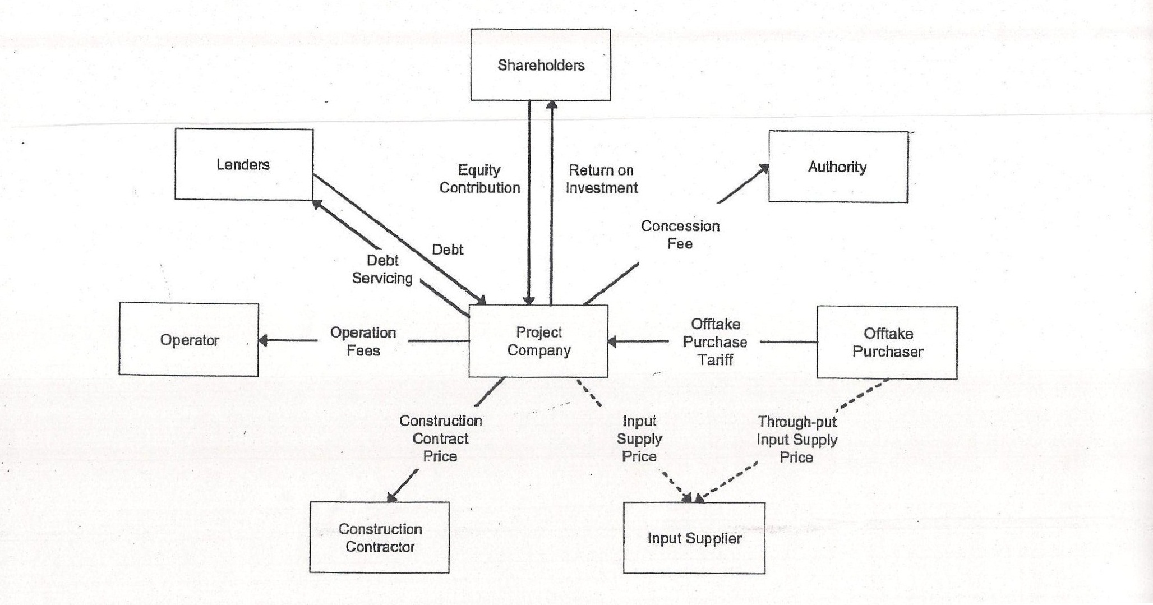

Slide 4
WEB OF CONTRACTUAL ARRANGEMENTS
Shareholders Agreement
  Sponsor Agreements
  Equity or subordinated Debt
  Restriction on share transfers
  Completion Guarantees
Concession Agreements / Implementation Agreement
Project Documents
  Equipment Supply Agreements
  Engineering, Procurement and Construction Agreements
  Off-Take Agreement
  Operations and Maintenance Agreement
  Input Supply Agreements
  Land Documents
  Consents and Approvals
  Bonds and Guarantees

Slide 5
Web of Contractual Arrangements (Continued)
Financing Agreements
    Limited Recourse Loans
    Financing and Term Sheet
    Common Terms Agreement
    Facility Agreements
    Project Funds Agreement
    Inter - Creditor Agreement

Slide 6
Security Documents and Security Creation
Memorandum of Deposit of Title Deeds (MODTD)
Letters of Hypothecation (LOH)
Security Trust Deeds
Assignment Deed
Direct Agreements
Letters of Lien
Share Pledge Agreements

Slide 7
Key Risks & Risk Allocation - I
Pre - Project Development Risks
  Concession Bonds and Guarantees
  Feasibility Study
  Project Company Formation
  Advisory fees (e.g legal, technical, financial, insurance etc.)
  Advance Payments to EPC Contractors
  Administrative Costs

Slide 8
Key Risks & Risk Allocation - II
CONSTRUCTION COMPLETION & COMMISSIONING RISKS
  TECHNOLOGY AND DESIGN
  PRICE
  UNFORESEEN SITE CONDITIONS
  ASSOCIATED INFRASTRUCTURE & ANCILLARY FACILITIES
  TRANSPORTATION
  COMMISSIONING AND TESTING
  VARIATION & CHANGE ORDERS
  DELAYS AND LIQUIDATED DAMAGES
  PERFORMANCE GUARANTEES AND LIQUIDATED DAMAGES
  DEFECTS LIABILITY
  COST-OVERRUNS
  FORCE MAJEURE
  CONTRACTOR PAYMENTS – BONDS AND GUARANTEES

Slide 9
Key Risks & Risk Allocation - III
Land Risks
  Due Diligence Issues
  Clear Title
  Encumbrances
Operational Period Market Risks
  Performance
  Off- take and Pricing
  Take or Pay
  Minimum Revenue Guarantees
  Inputs availability and Pricing
  Payment Securities
  Force Majeure
  Machinery Breakdown

Slide 10
Key Risks & Risk Allocation - IV
Force Majeure
  Relationship with Insurances
  Compensation and Reliefs
Political Risks
  Change in Law
  Change in Taxes and custom duties
  Change in Governments and policies
  Foreign Exchange Availability
  Consents and Approvals
  Law and order and security situation

Slide 11
Key Risks & Risk Allocation - V
  Loss or Damage to Assets
  Title to Asset Risks
  Environmental Risks
  Intellectual Property Rights Risks
  Exchange Rate Risk
  Insolvency Risks
  Default Risks
  Dispute Resolution
  Limitation of Liability

Slide 12
THANK YOU

Slide 13
Public Private Partnerships
Procurement Risks
The Bidding Process
Unsolicited Bids

Slide 14
Foreign Financing
Import of Plant Machinery
Foreign Account Issues
Non Resident Pledge Issue
Advance Payment Related Issues

